Slide 1

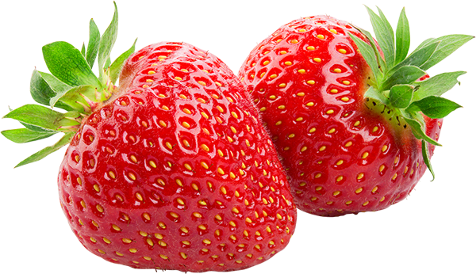
Molecular Nutrition
Work in Progress 2
Radhika Patel and Reilly Cashmore
7/20/2017

Slide 2
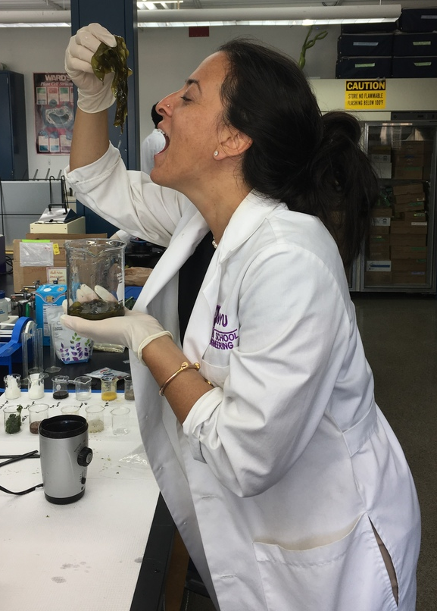
Overview
Objective
Background Information
Experiments
Test Results/ Conclusions
Difficulties
Improvements
Upcoming Tasks

Slide 3

Objective
Develop lab experiments for a Molecular Nutrition Course
Test different foods/supplements for nutritional info
Investigate health properties of different types of diets
Investigate the claims about raved “superfoods”

Slide 4
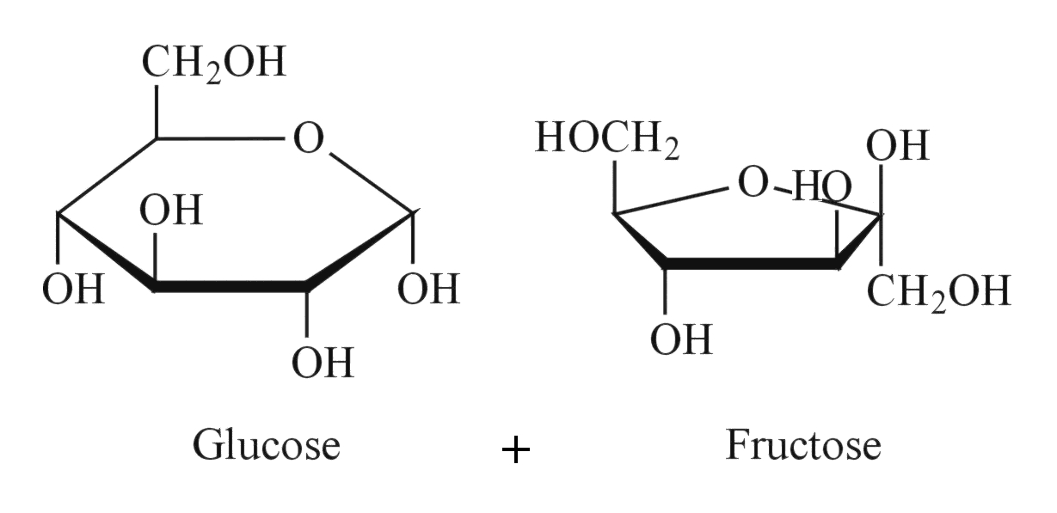
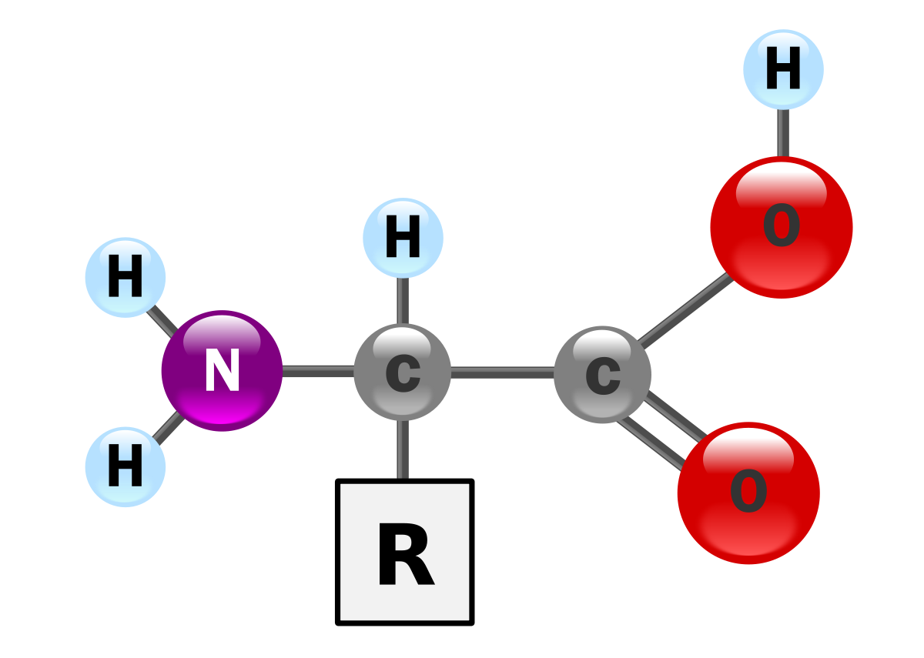
Background Information
Macro/micronutrients
Carbohydrates
Amino Acids
Vitamins
Minerals

Slide 5
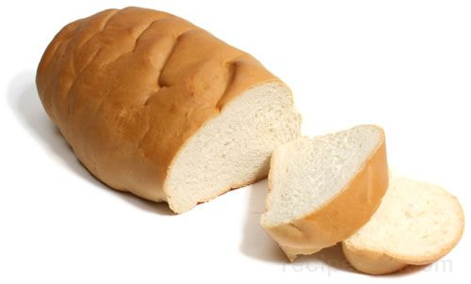
Carbohydrates
Glucose!
Available vs. Unavailable
available: broken down into monosaccharide in small intestine
unavailable: fermented in large intestine; forms fatty acids
Monosaccharides, Disaccharides, Polysaccharides

Slide 6
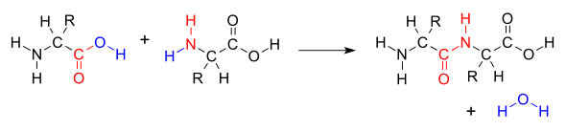
Amino Acids
Essential vs. Nonessential
20 common amino acids
9 of 20 are essential

Slide 7
Adulteration of Milk
Objective: To detect various adulterants present in milk using specific biochemical tests.
Purpose:
important to assure adulterant free milk for consumption.
Adulteration of milk reduces the quality of milk and can even make it hazardous.
soap, acid, starch, table sugar and chemicals like formalin
Added to increase the shelf life of milk
Some of the preservatives like acid and formalin
Water is added to the milk to increase the volume content of the milk.

Slide 8

Lab 1: Carbohydrates
Fehling’s Test: presence of reducing sugar
Benedict’s Test: presence of reducing sugar concentration
Barfoed’s Test: presence of reducing sugars (will have a thin film at the bottom of the test tube to indicate reducing monosaccharides)
Iodine Test: presence of polysaccharides
Bial’s Test: presence of pentoses and hexoses

Slide 9
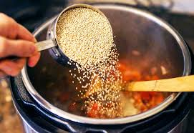
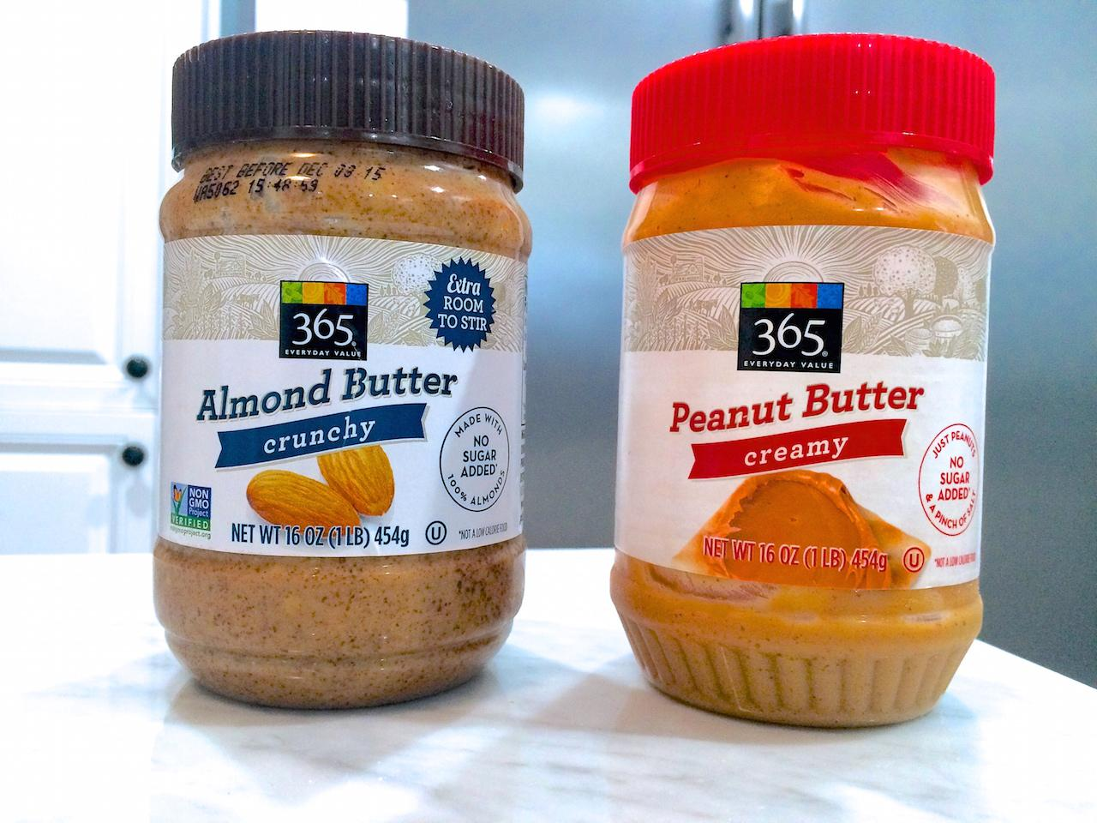
Lab 1: Carbohydrates
Items Tested:
Rice
Quinoa
Coconut oil
Lentils
Green Tea
Pb
Ab
Hemp
Plant protein
Chia
Seitan

Slide 10

Changes Made to Lab
diluted substances
10 % v/v
10 % w/v
5% w/v (for chia seeds)
use different solvents for dilutions
distilled water
acetone
pH 7 buffer
made a protocol procedure for work studies to repeat

Slide 11
Experimental Results
Distilled Water
pH 7 Buffer
Acetone
Substance | Benedict | Iodine | Fehling | Barfoed | Bial
Chia | blue | no change | royal blue | blue | yellow
Hemp Seeds | blue slight purple | No change | purple black | blue | yellow
Peanut butter | blue | no change | blue purp | blue | slight red particles
almond butter | blue | no change | blue purp | blue | slight red particles
seitan | green | black | royal blue | blue | yellow
di water | blue | no change | dark green | blue | yellow
lentils | dark green | black | dark green | blue slight green | red
rice | blue-green | black | dark green | blue | yellow
quinoa | green | black | dark green | green | yellow
coconut oil | blue | no change | dark green | blue | yellow
green tea | slight green | no change | dark green | green bright | yellow
plant protein | grey | no change | purple | blue slight green | grey?
W/V | 10% | V/V | 10%
W/v Chia | 5%
Substance | Benedict | Iodine | Fehling | Barfoed | Bial
Chia | blue | no | dark blue | baby blue | yellow
Hemp | blue purple | no | royal blue | baby blue | yellow
Peanut butter | blue | black | royal blue | baby blue | yellow
almond butter | blue | no | dark blue | baby blue | yellow
seitan | green | black | dark green | baby blue | yellow
PH 7 | blue | no | green | baby blue | yellow
lentils | dark green | black | dark green | baby blue | red
rice | turquoise | black | dark blue green | baby blue | yellow
quinoa | green | black | green | baby blue | yellow
coconut oil | blue | no | green | baby blue | yellow
green tea | dark green | no | green | green | orange
plant protein | grey | black | purple | baby blue | grey
W/V | 10%
Substance | Benedict | Iodine | Fehling | Barfoed | Bial
Chia | blue | no rxn | purp | blue | black
Hemp | blue | no rxn | purp | blue | black
Peanut butter | blue | no rxn | purp | turquoise | black
almond butter | blue | no rxn | purp | turquoise | black
seitan | blue | no rxn | blue | blue | yellow
Acetone | blue | no rxn | blue | blue | yellow
lentils | blue | no rxn | blue | blue | red
rice | blue | no rxn | blue | blue | orangey
quinoa | blue | no rxn | blue | blue | orangey
coconut oil | blue | no rxn | blue | blue | yellow
green tea | green | no rxn | dark blue | green | red
plant protein | blue | no rxn | dark blue | turquoise | black
W/V | 10%
___ = positive results

Slide 12
Conclusions about Lab 1
SOLVENT: pH 7 BUFFER
Fehling’s Test
(presence of reducing sugar)
chia
hemp
peanut butter
almond butter
plant protein
Benedict’s Test
(presence of reducing sugar)
Seitan
Lentils
Rice
Quinoa
Green Tea
Barfoed’s Test
(presence of reducing sugar)
Green Tea

Slide 13
Conclusions about Lab 1
SOLVENT: pH 7 BUFFER
Bial’s Test
(presence of polysaccharides)
Lentils
Green Tea
Plant Protein
Iodine Test
(presence of pentoses and hexoses)
Peanut Butter
Seitan
Lentils
Rice
Quinoa
Plant Protein

Slide 14
Lab 2: Amino Acids
Xanthoproteic Acid Test: presence of aromatic amino acids
Hopkins-Cole Test: presence of tryptophan
Lead Sulfide Test: presence of sulfur containing amino acids
Ninhydrin Test: presence of any amino acid or proline/hydroxyproline
Pauly’s Diazo Test: presence of histidine or tryptophan
Isatin Test: presence of proline/hydroxyproline

Slide 15
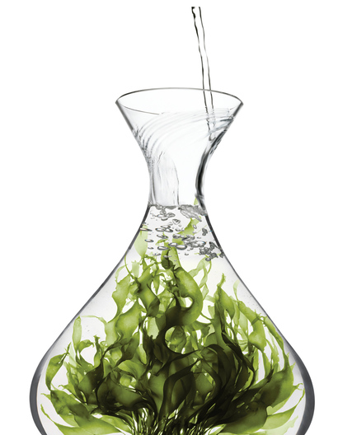

Lab 2: Amino Acids
Items Tested:
DI Water
Soy aminos
Coconut oil
Flax seed
Plant Protein
Kale
Chia seeds
Quinoa
Lentils
Nutritional Yeast
Rice
egg

Slide 16
Changes Made to Lab
diluted substances
10 % v/v
10 % w/v
5% w/v (for chia seeds)
tested different solvents for dilutions
distilled water
pH 7 buffer
made a protocol procedure for work studies to repeat
added 3 new tests

Slide 17
Amino Acid Solvent Tests
 | Xantho | Hopkins | Lead
DI Water | negative | no ring?? | negative
rice | positive | no ring?? | positive
quinoa | positive | no ring?? | positive
coconut oil | negative | no ring?? | positive
lentils | positive | no ring?? | positive
hemp | positive | no ring?? | positive
plant protein | positive | no ring?? | positive
chia | positive | no ring?? | positive
egg | positive | no ring?? | positive
yeast | positive | no ring?? | positive
soy amino | negative | no ring?? | positive
kale | positive | no ring?? | positive
 | Xantho | Hopkins | Lead
PH 7 Buffer | negative | slight pink no ring | positive
rice | positive | no ring | positive
quinoa | positive | no ring | positive
coconut oil | negative | no ring | positive
lentils | positive | no ring | positive
hemp | positive | no ring | positive
plant protein | positive | no ring | positive
chia | positive | no ring | positive
egg | positive | no ring | positive
yeast | positive | no ring | positive
soy amino | negative | no ring | positive
kale | negative | no ring | positive
___ = positive results

Slide 18
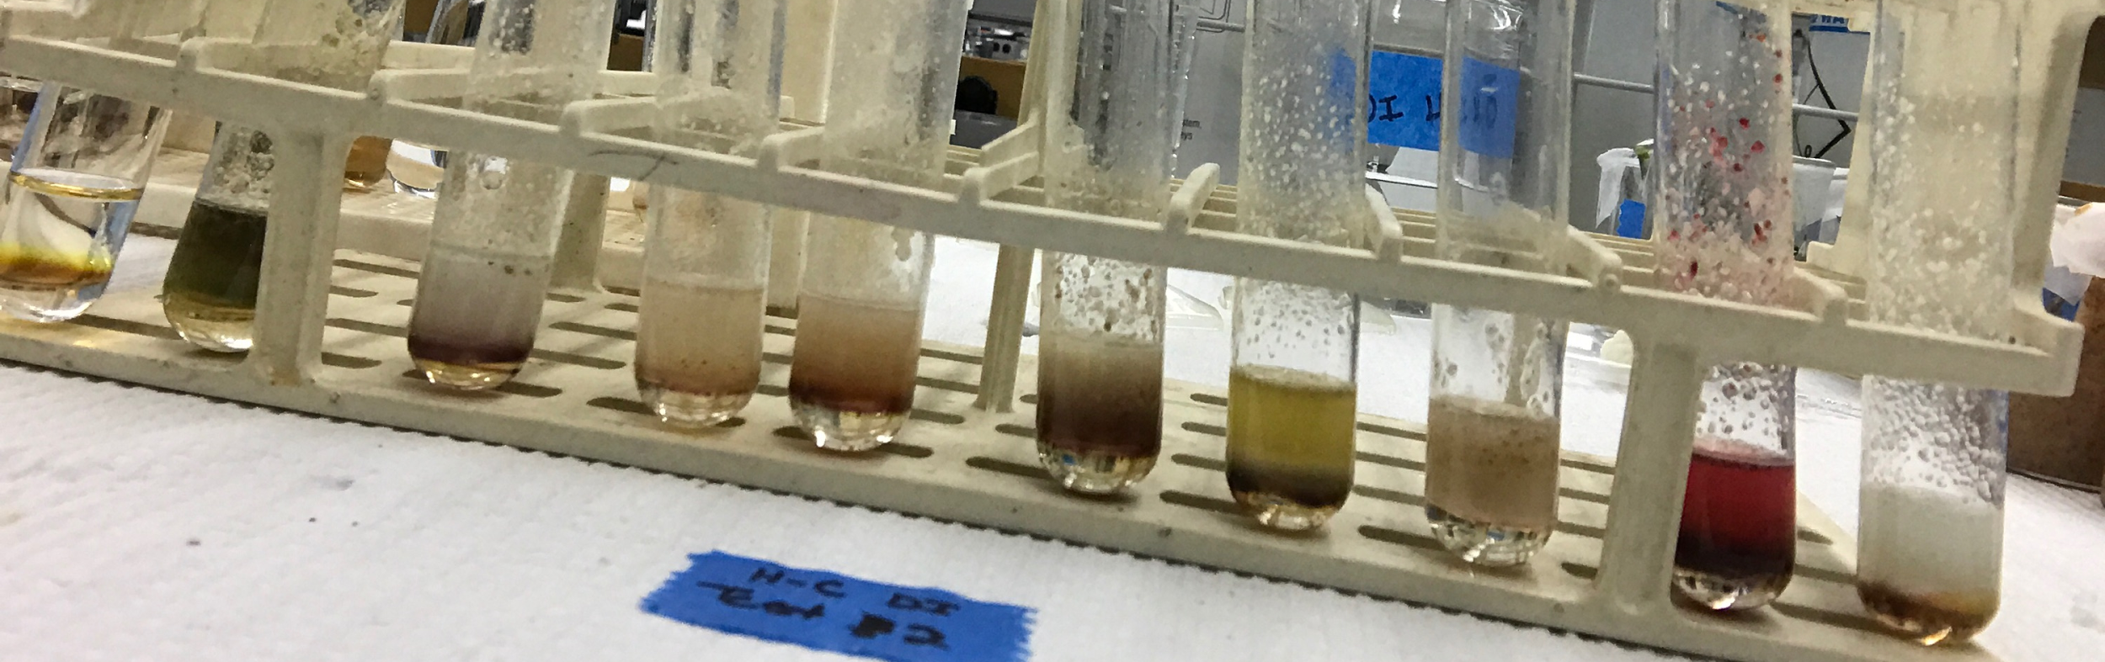
Hopkins-Cole Repeat
green tea, spinach, hemp, almond butter, peanut butter, flax, nut. yeast, chia, lentil quinoa
Figure 1. Hopkins- Cole Test

Slide 19
New Amino Acid Tests
Ninhydrin Test: presence of any amino acid or proline/hydroxyproline
Pauly’s Diazo Test: presence of histidine or tryptophan
Isatin Test: presence of proline/hydroxyproline

Slide 20
Substances Tested
Rice
Quinoa
Lentils
Icelandic Yogurt
Arame
Sea Crunchy Seaweed Snack
Peanut Butter
Almond Butter

Slide 21
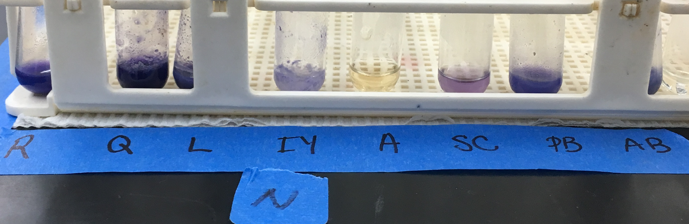
Ninhydrin Test Results
Figure 2. Ninhydrin Test

Slide 22
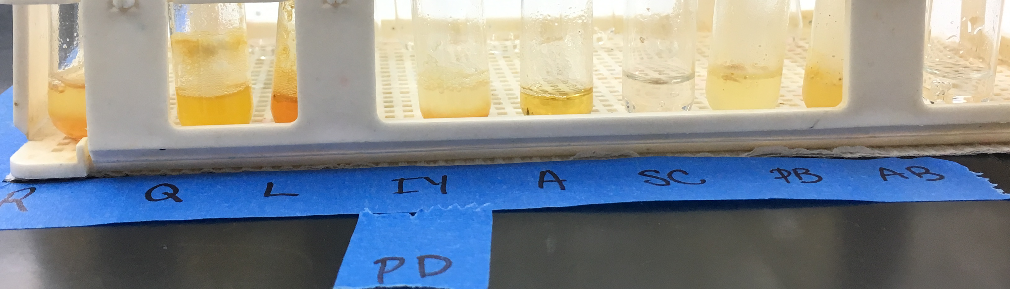
Pauly’s Diazo Test Results
Figure 3. Pauly’s Diazo Test

Slide 23
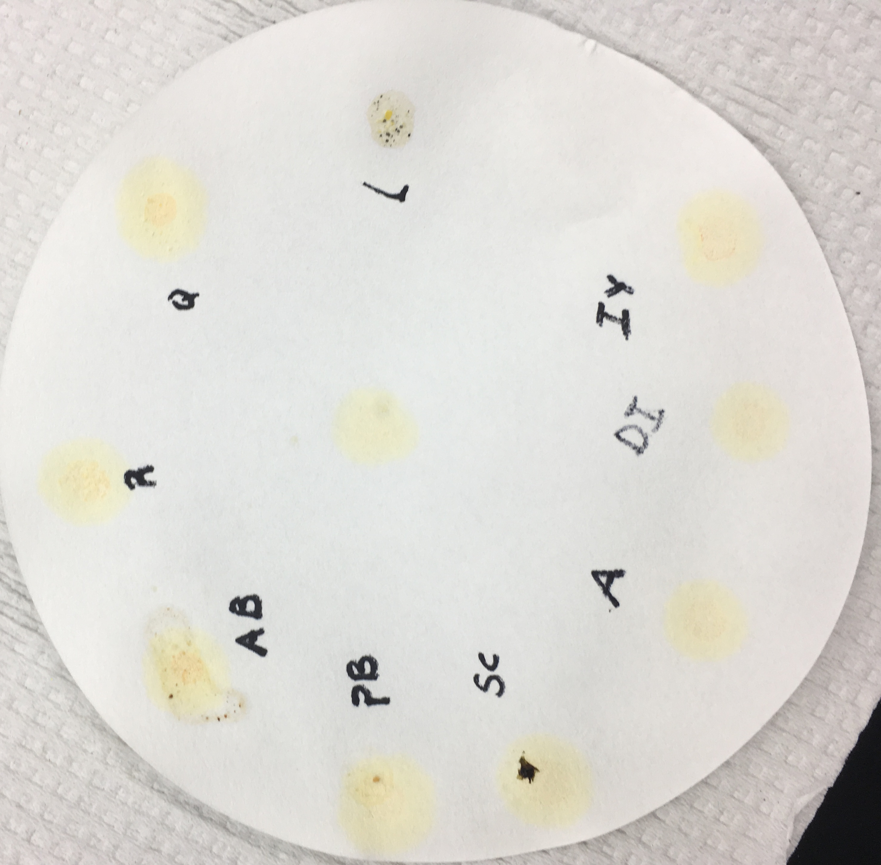
Isatin Test Results
Figure 4. Isatin Test

Slide 24
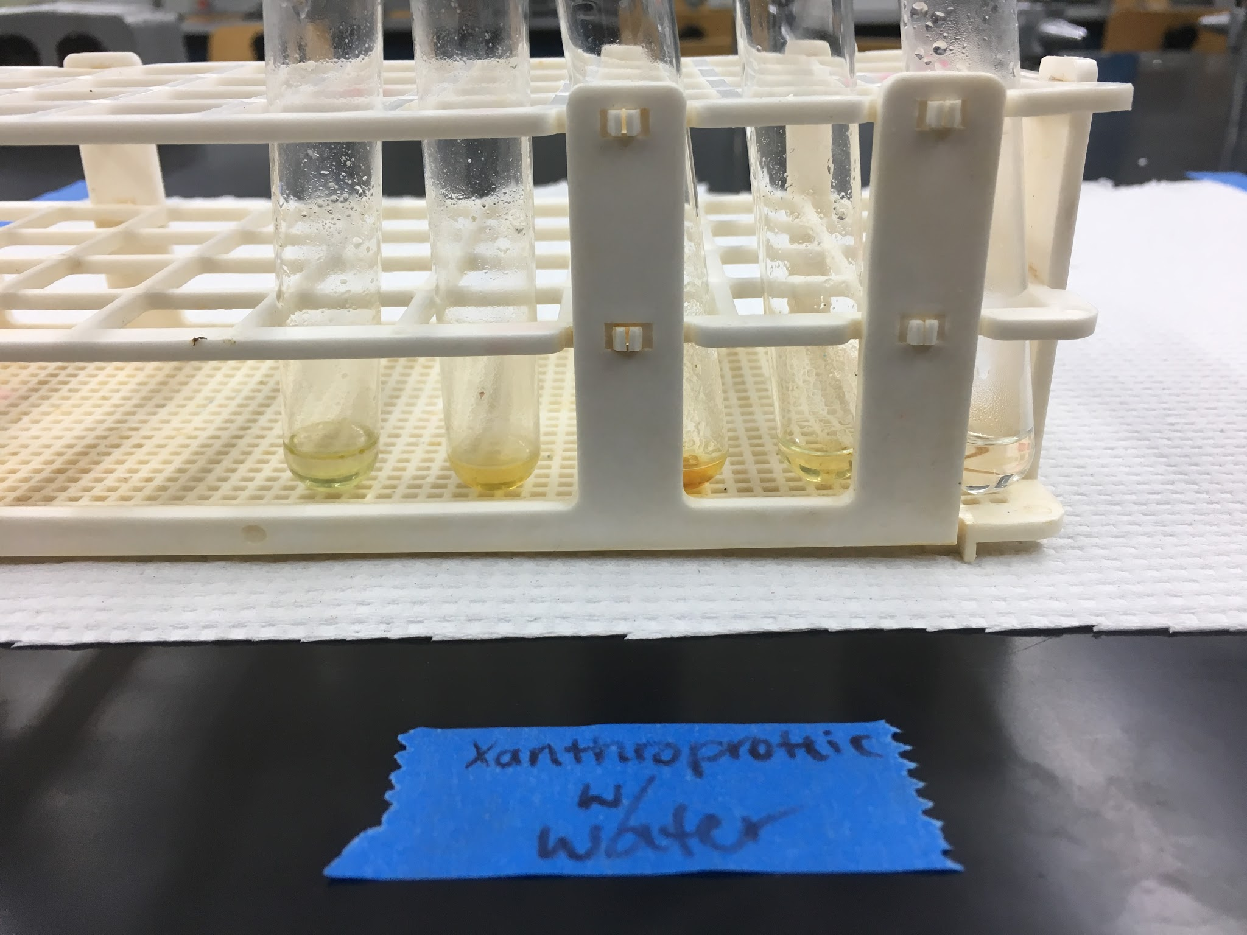
Seaweed Testing
What we did:
Weigh 2 g out
Grind the 2 g and put in 50 mL beaker of DI water to soak for ten minutes
Use scoopula to take some of the soaked seaweed out into a microcentrifuge tube
Centrifuge tube for 3 minutes at 30000 rpm
Use 1 mL pipettes to take the extract off the top of the tube to put into test tube
Results:
Figure 5. Extraction of Seaweed with Xanthoproteic Test
We need help and suggestions!

Slide 25
Adulteration of Milk
Types of Adulteration Test
Microorganism:
Milk may contain some harmful microorganisms like bacteria along with some potentially beneficial microbes.
Pasteurization is done to destroy such harmful bacteria.
This test works on the principle that the methylene blue indicator is present in an oxidized form, but in the presence of bacteria
Table Sugar:
The common sugar present in milk is lactose.
Table sugar like sucrose is added to the milk to increase the carbohydrate content of the milk
Soap:
Soap is added to milk to increase the foaming of milk and thus to have thick milk.
Addition of such chemicals will cause health problem especially related to stomach and kidneys.
Formalin:
Formalin is a preservative and can preserve milk for long period of time.
Due to its high toxicity, it is considered to cause liver and kidney damage.

Slide 26
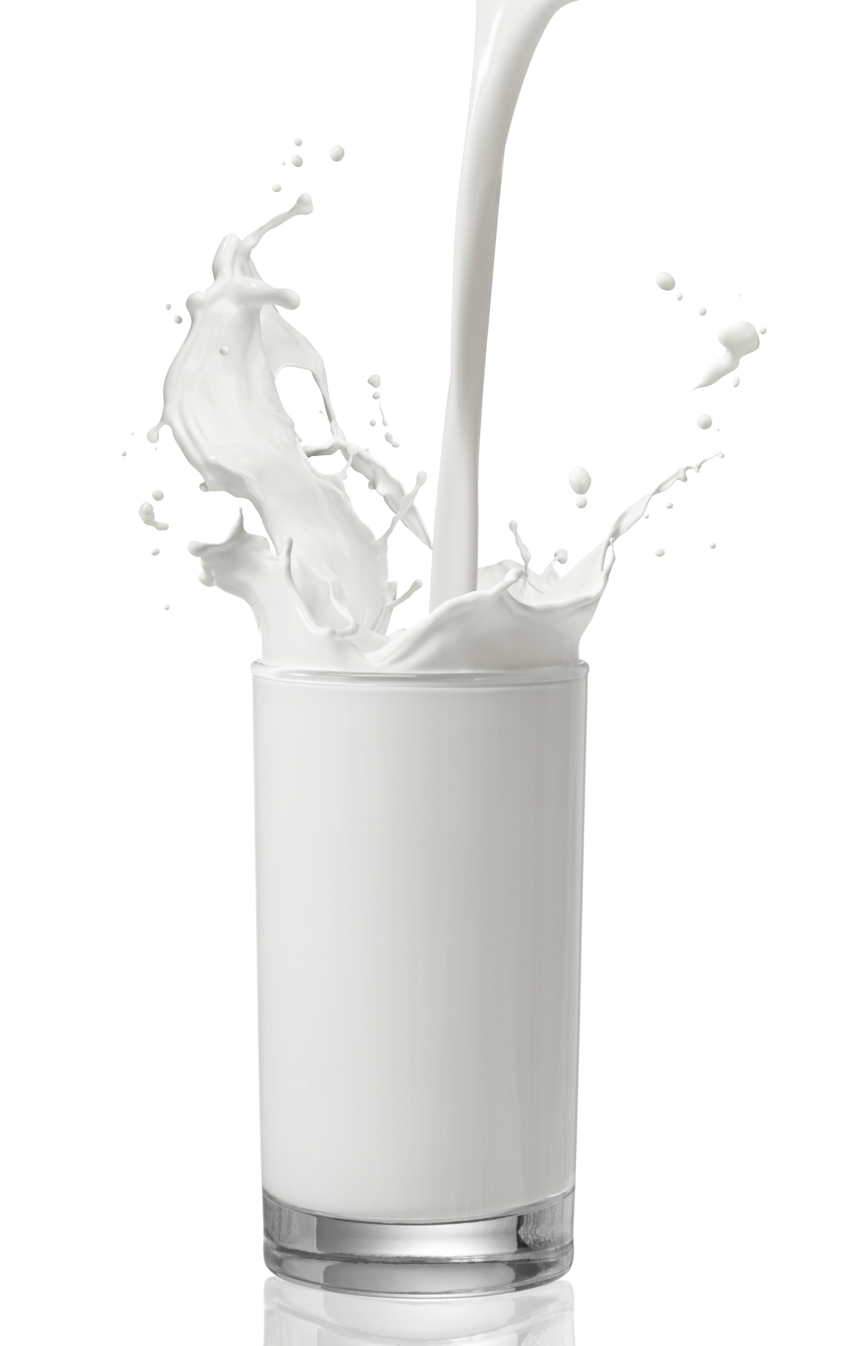
Adulteration of Milk: Milk Types Experiment
Items Tested
Califia Almond Milk
Pacific Hemp Milk
So Delicious Cashew Milk
So Delicious Coconut Milk
Organic Valley Whole Milk
Organic Valley 2% Milk

Slide 27
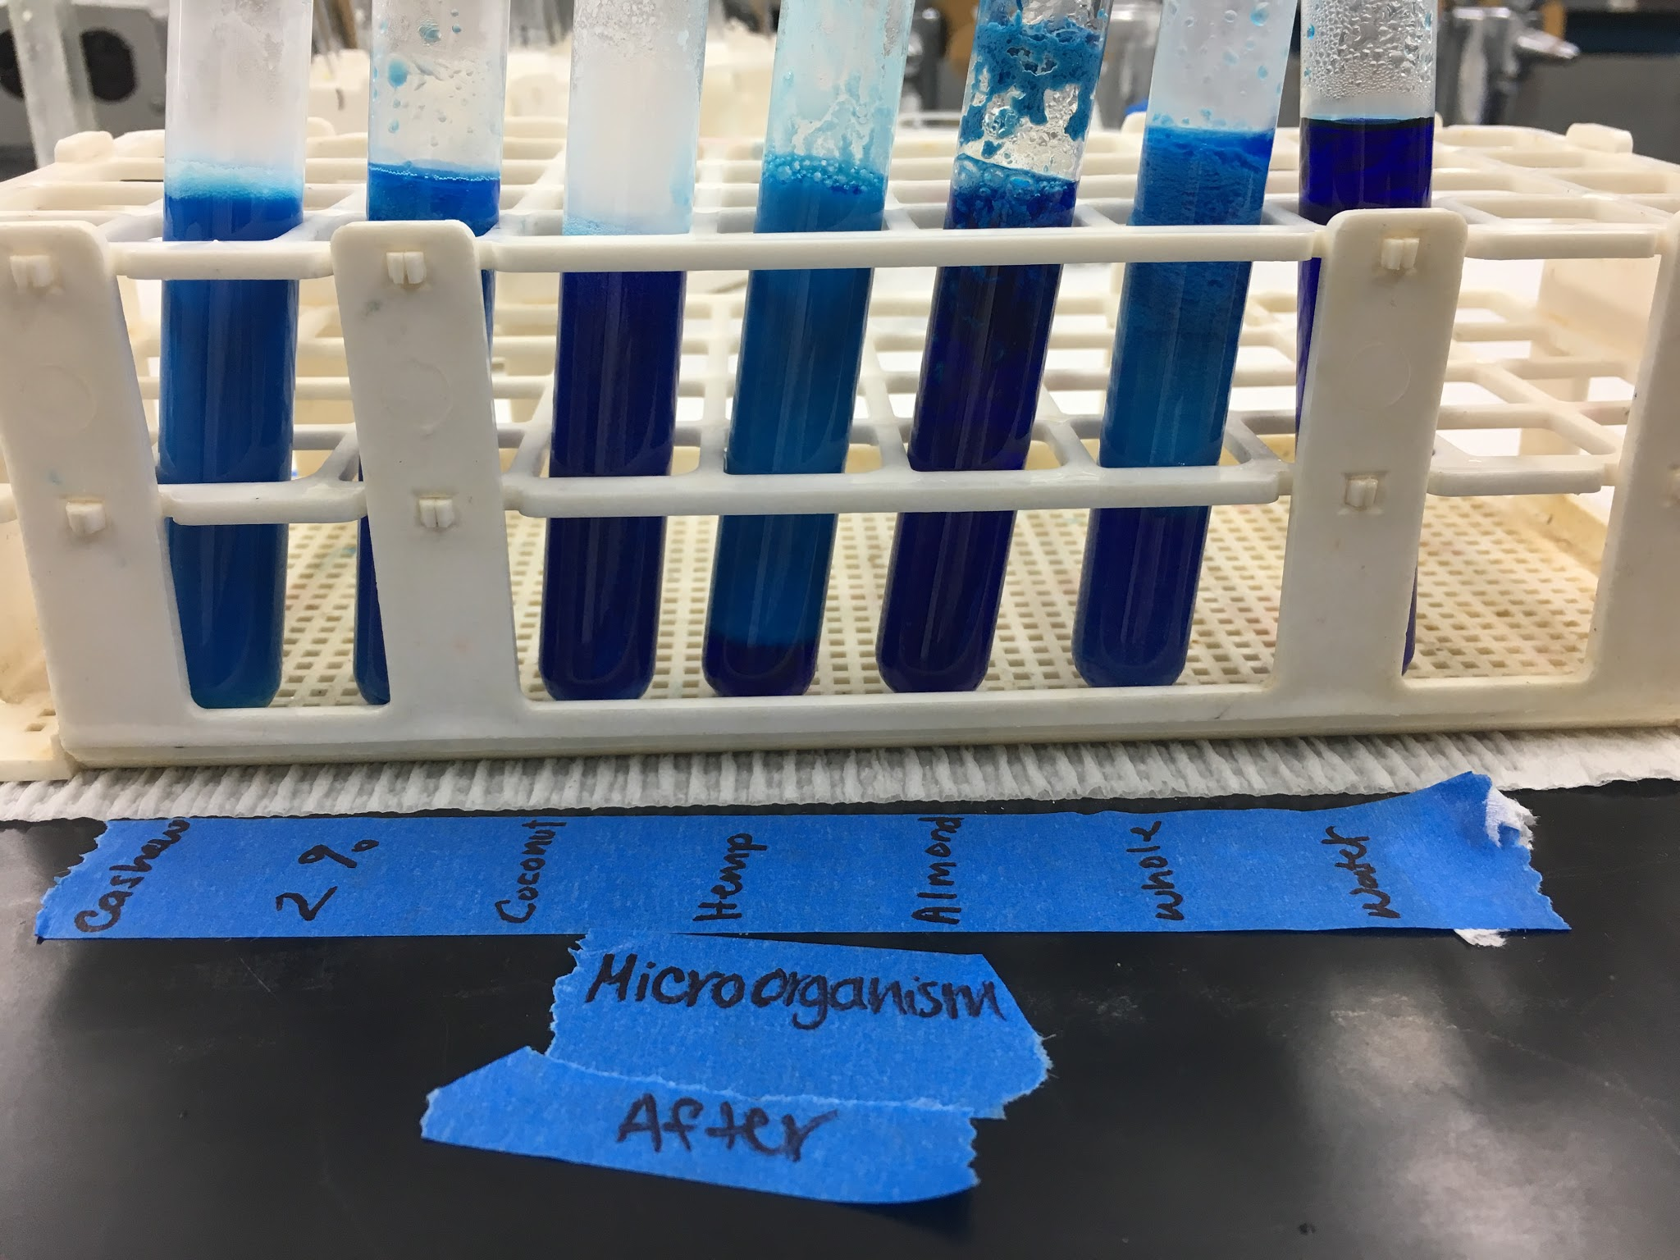
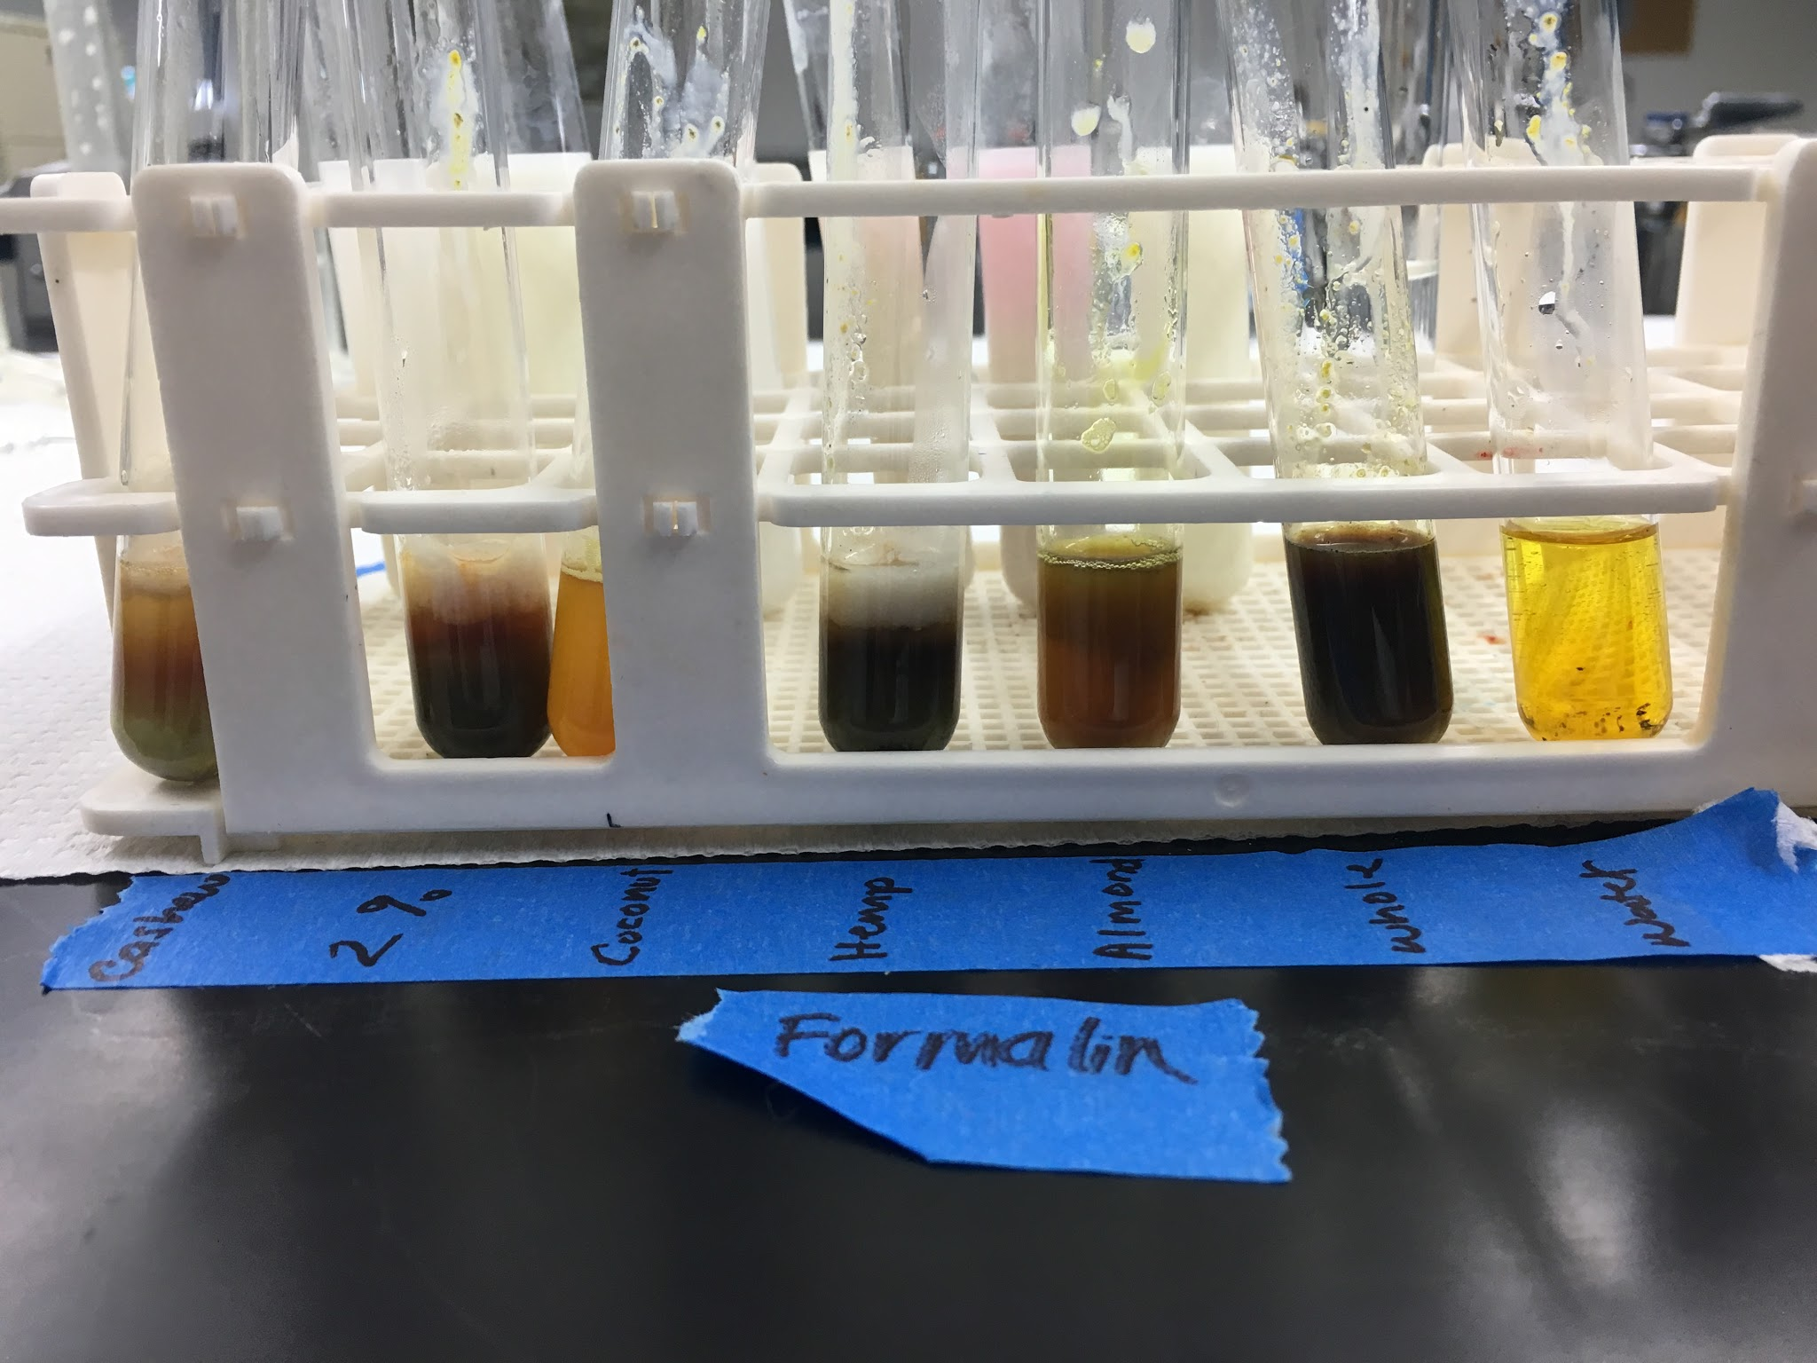
Adulteration of Milk: Milk Types Results
Results
Figure 6. Microorganism Test Figure 7. Formalin Test

Slide 28
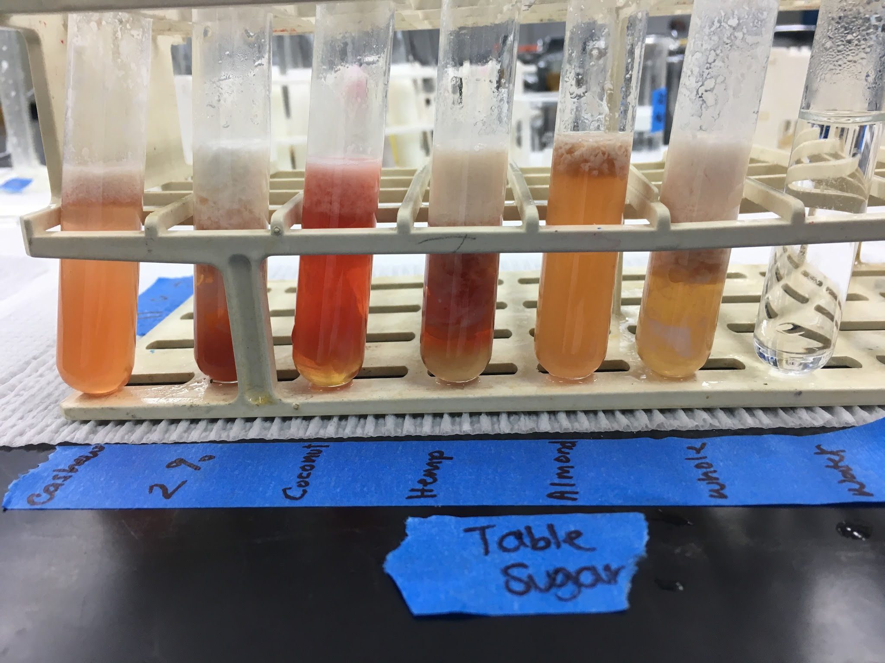
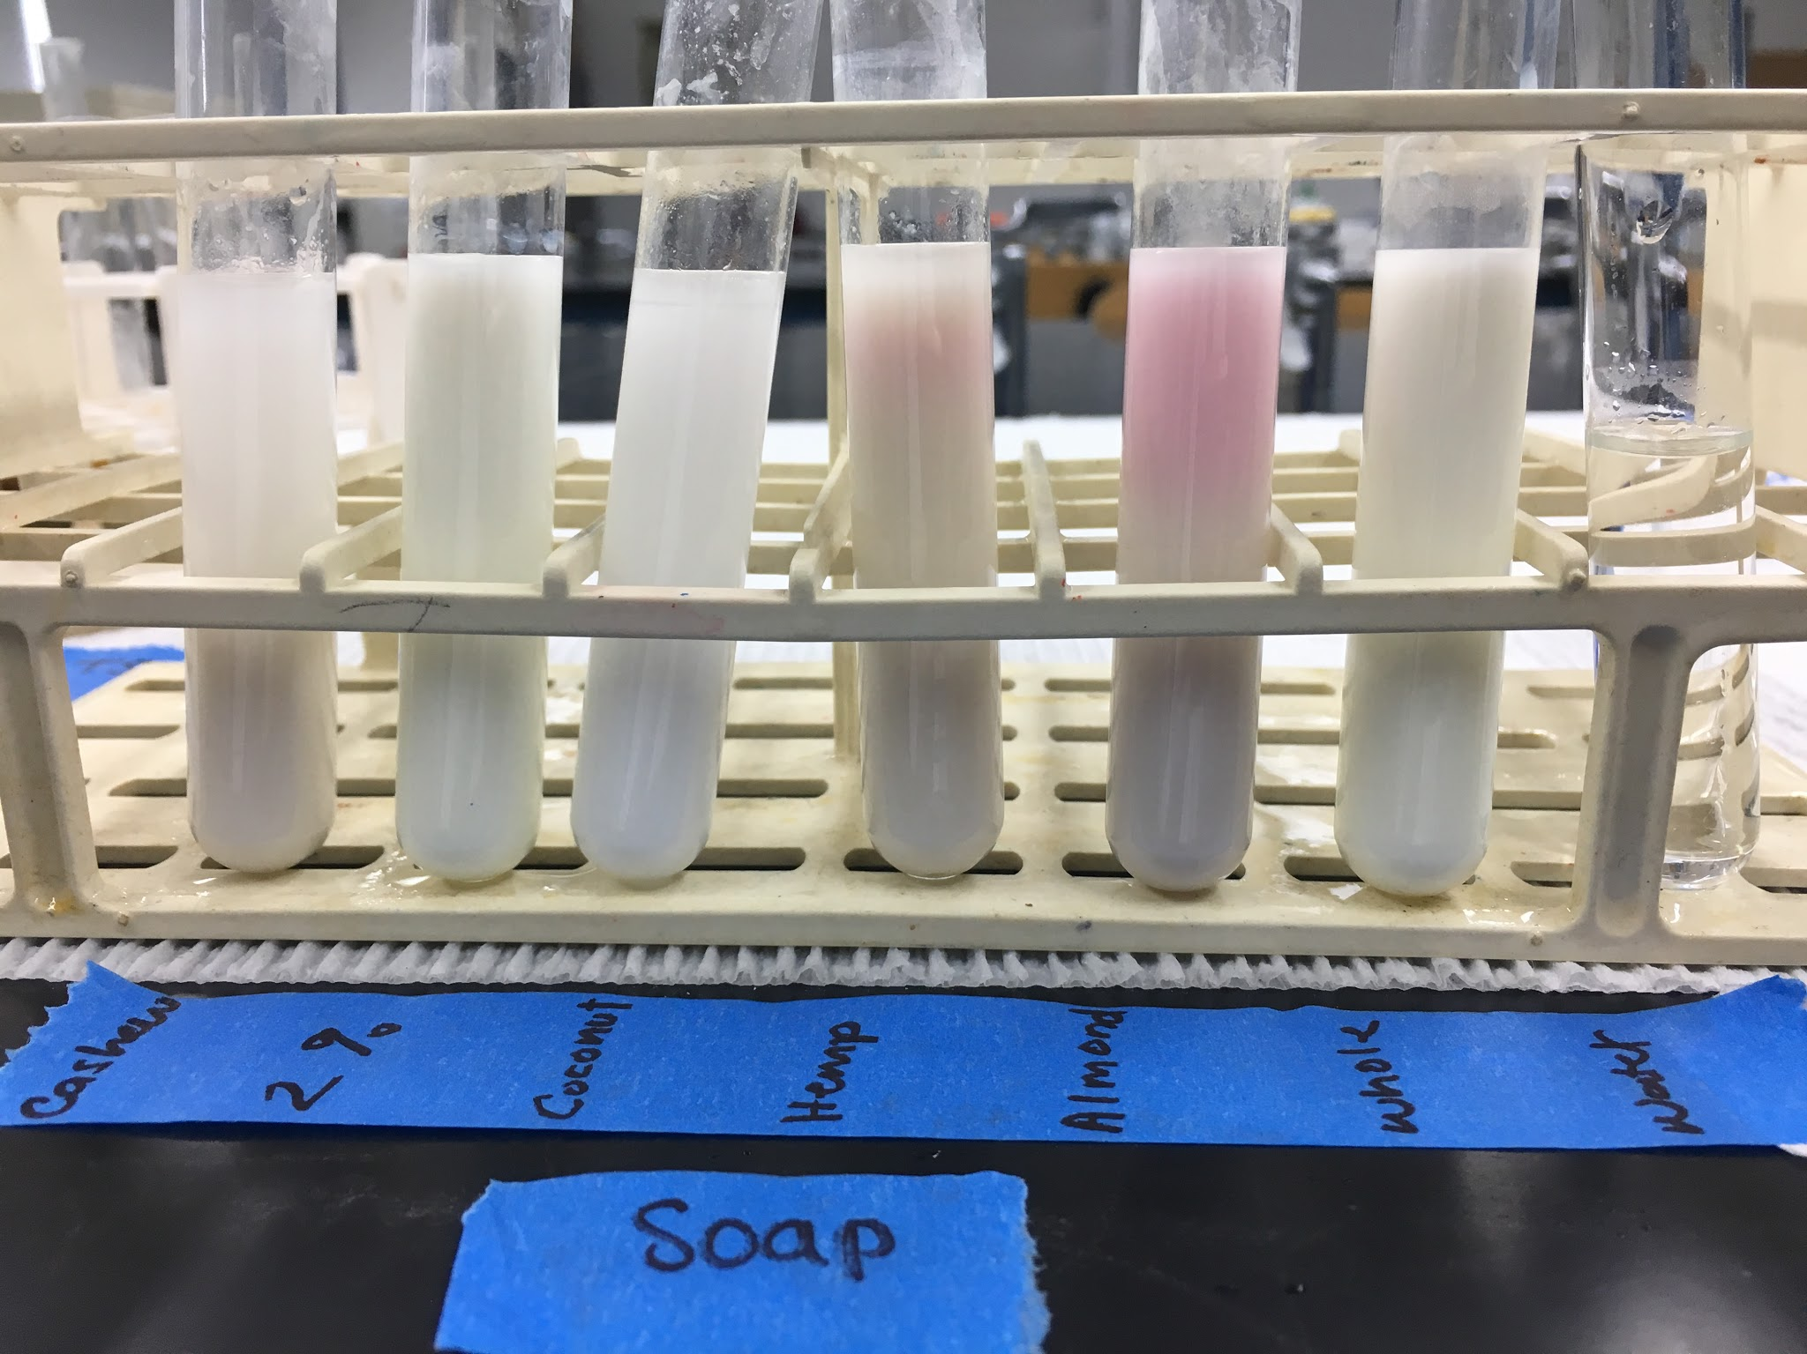
Adulteration of Milk: Milk Types Results
Results
Figure 8. Table Sugar Test Figure 9. Soap Test

Slide 29
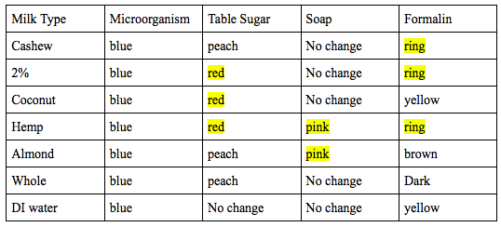
Adulteration of Milk: Milk Types Results
Results
___ = positive results

Slide 30
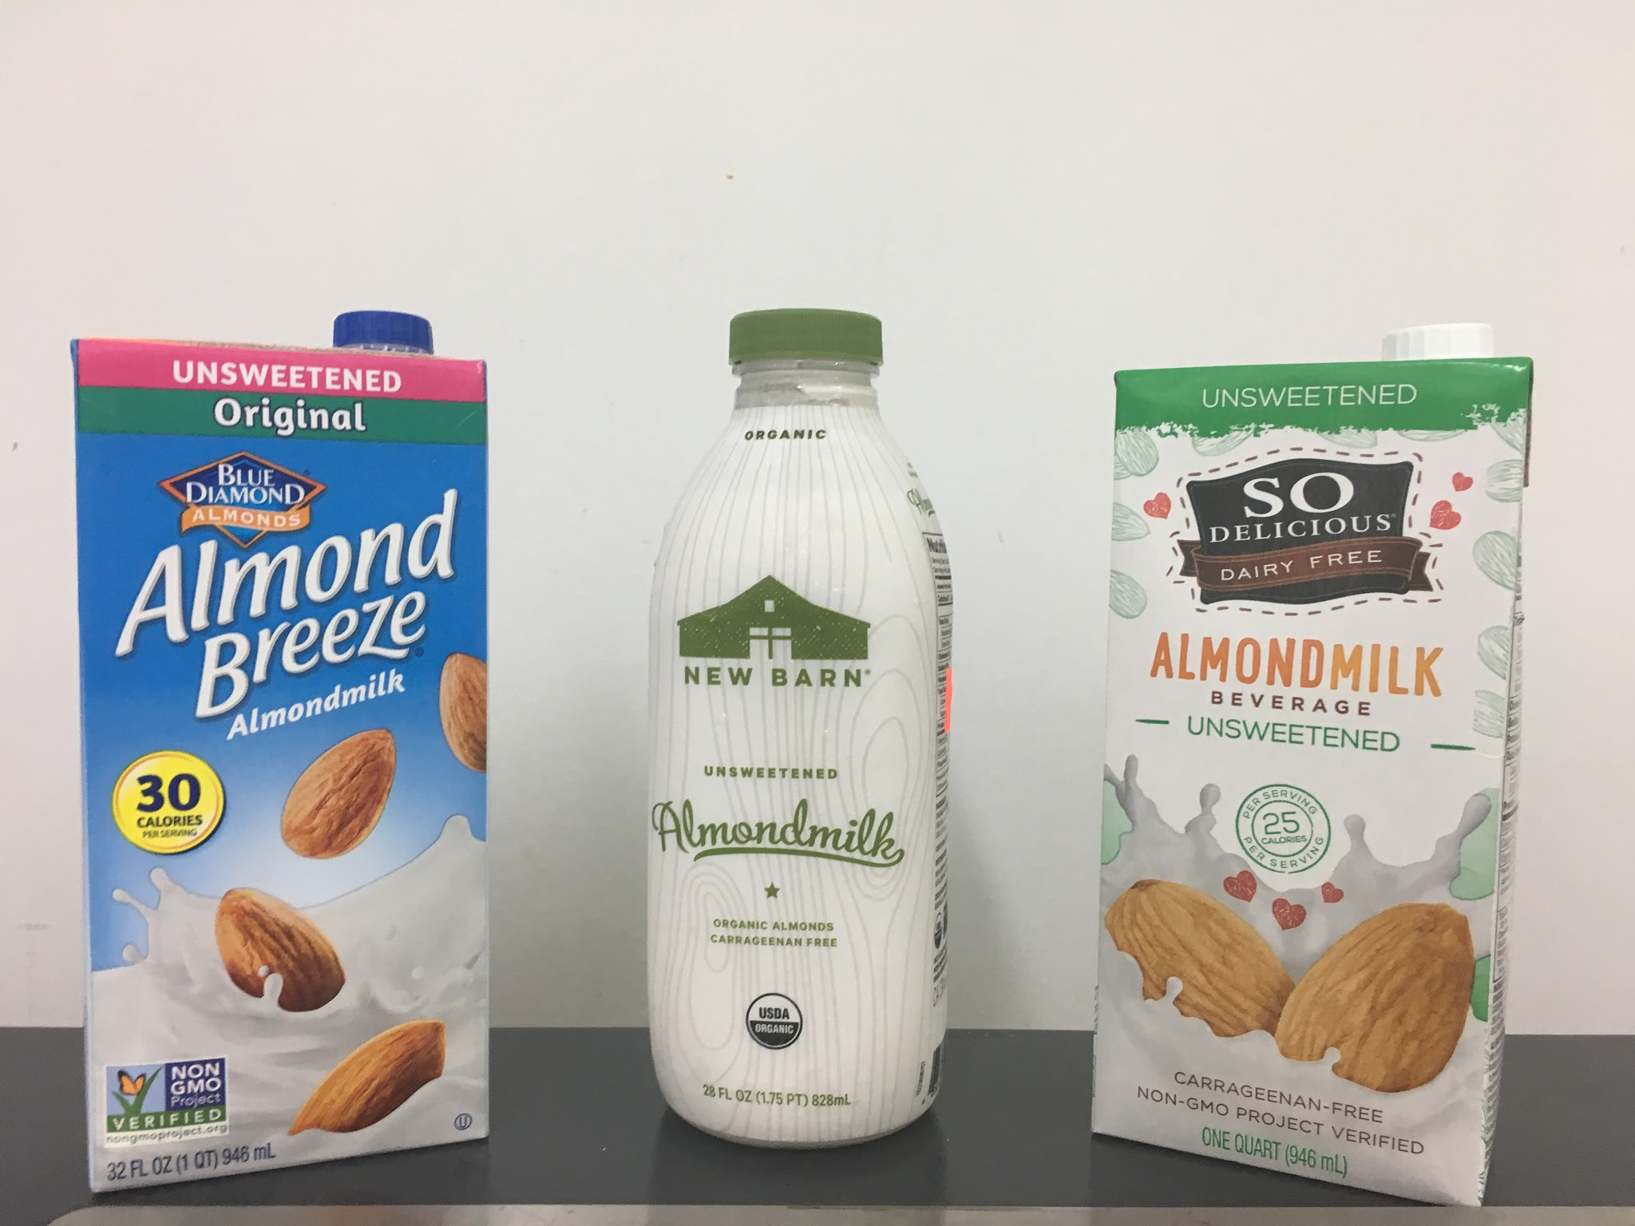
Adulteration of Milk: Almond Milk Comparison Experiment
Items Tested
Califia Almond Milk
So Delicious Almond Milk
Almond Breeze
New Barn Organic Almond Milk

Slide 31
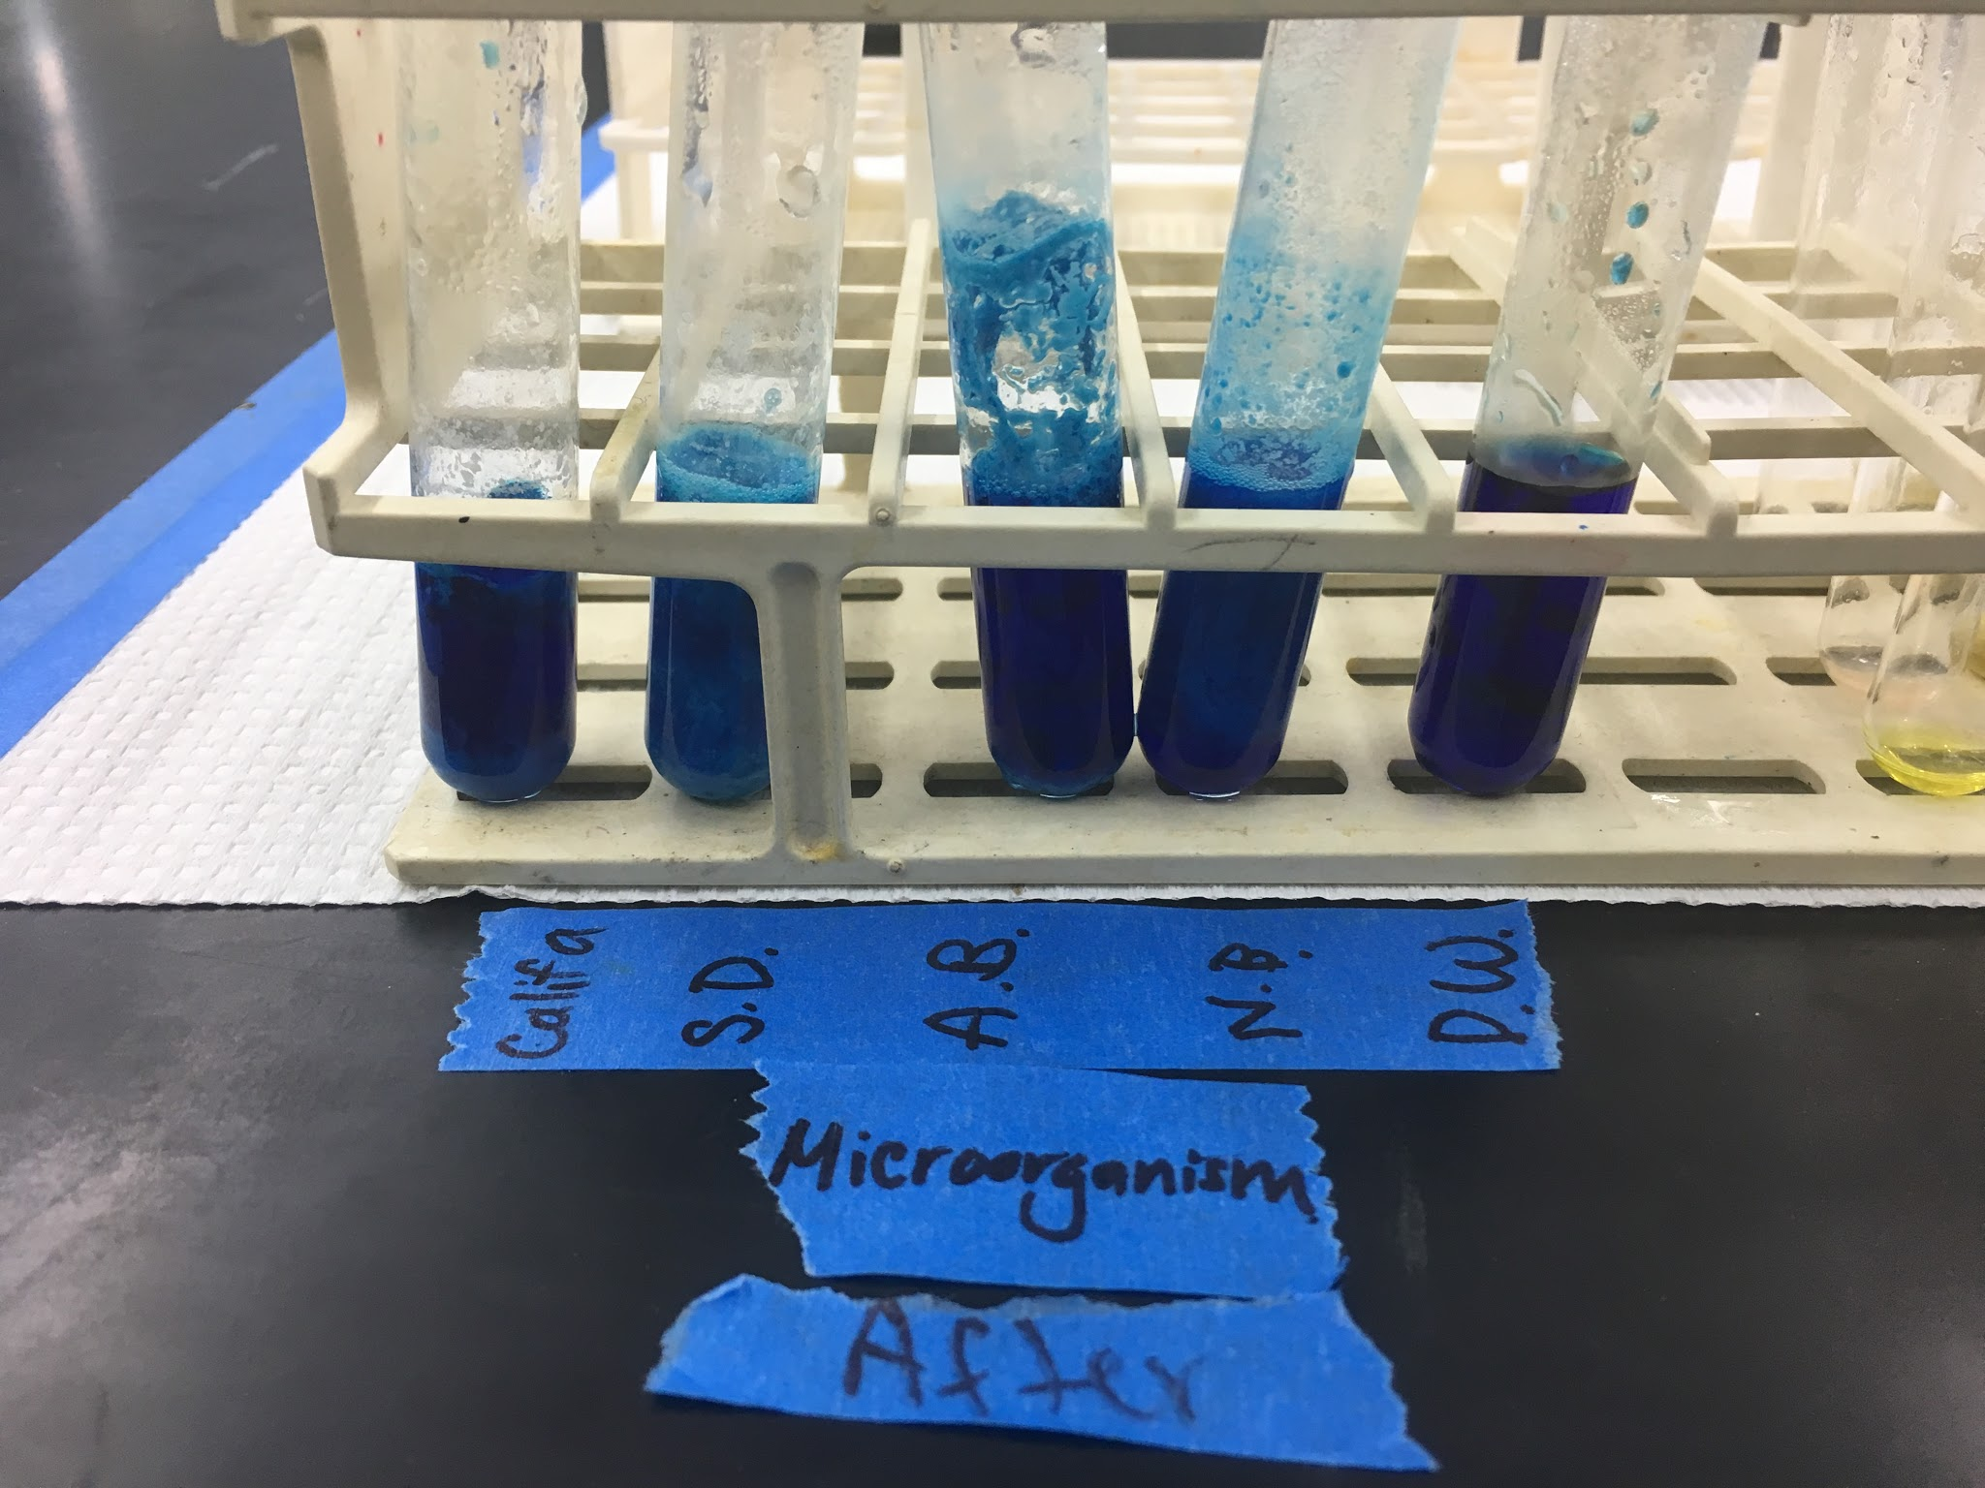
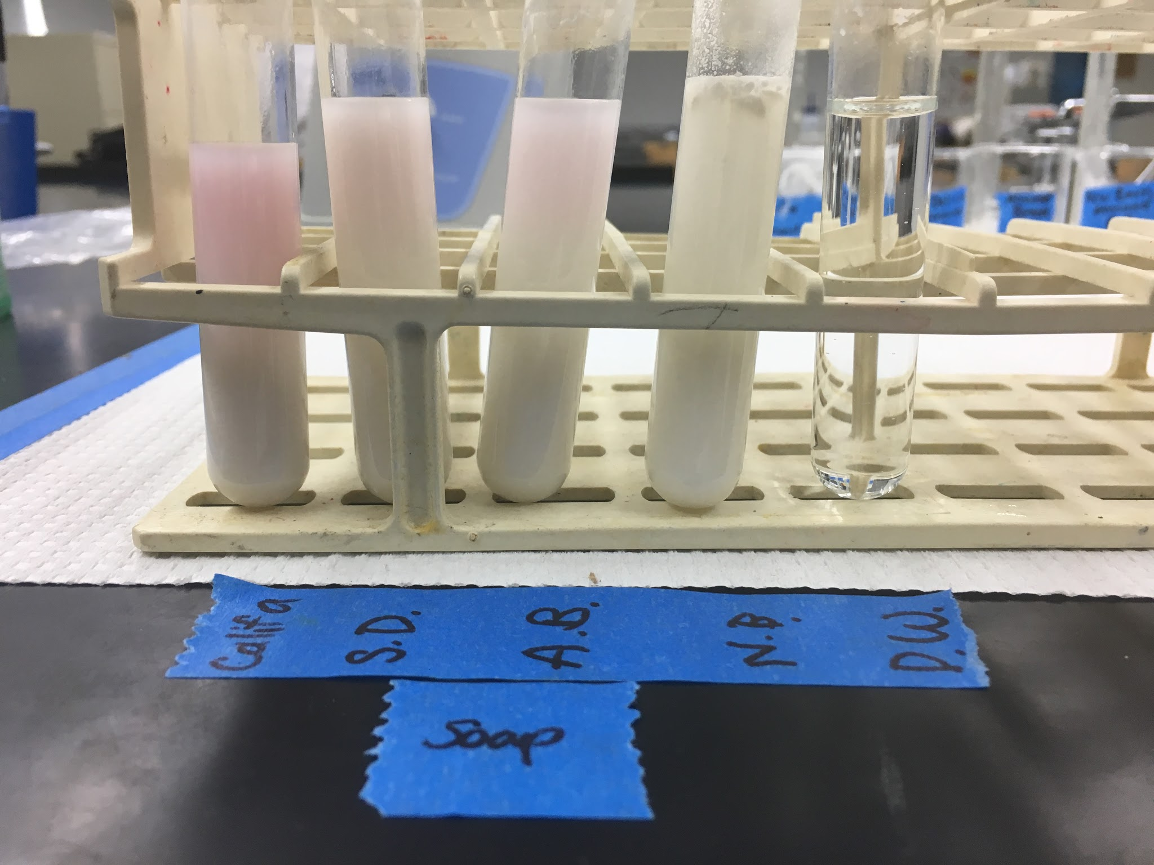
Adulteration of Milk: Almond Milk Brands Results
Results
Figure 10. Microorganism Test Figure 11. Soap Test

Slide 32
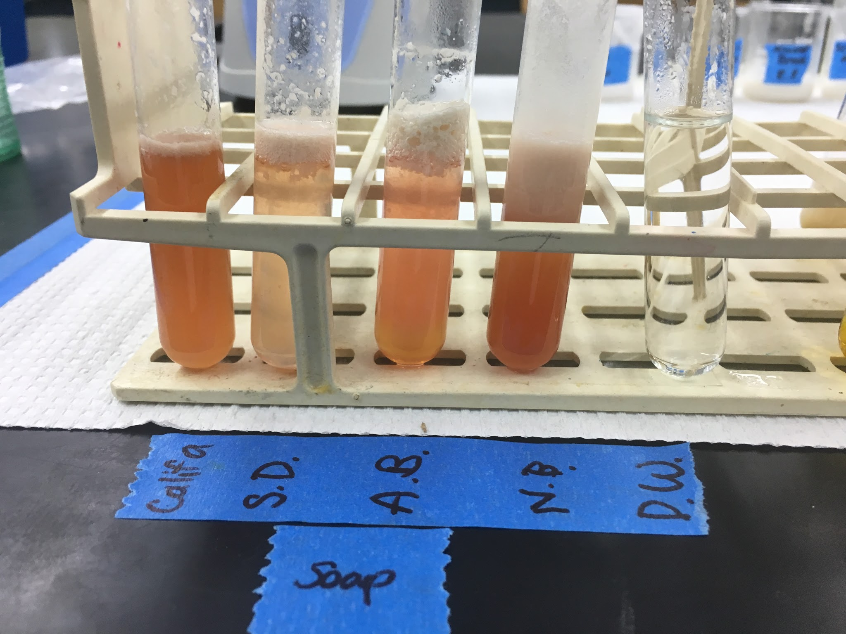
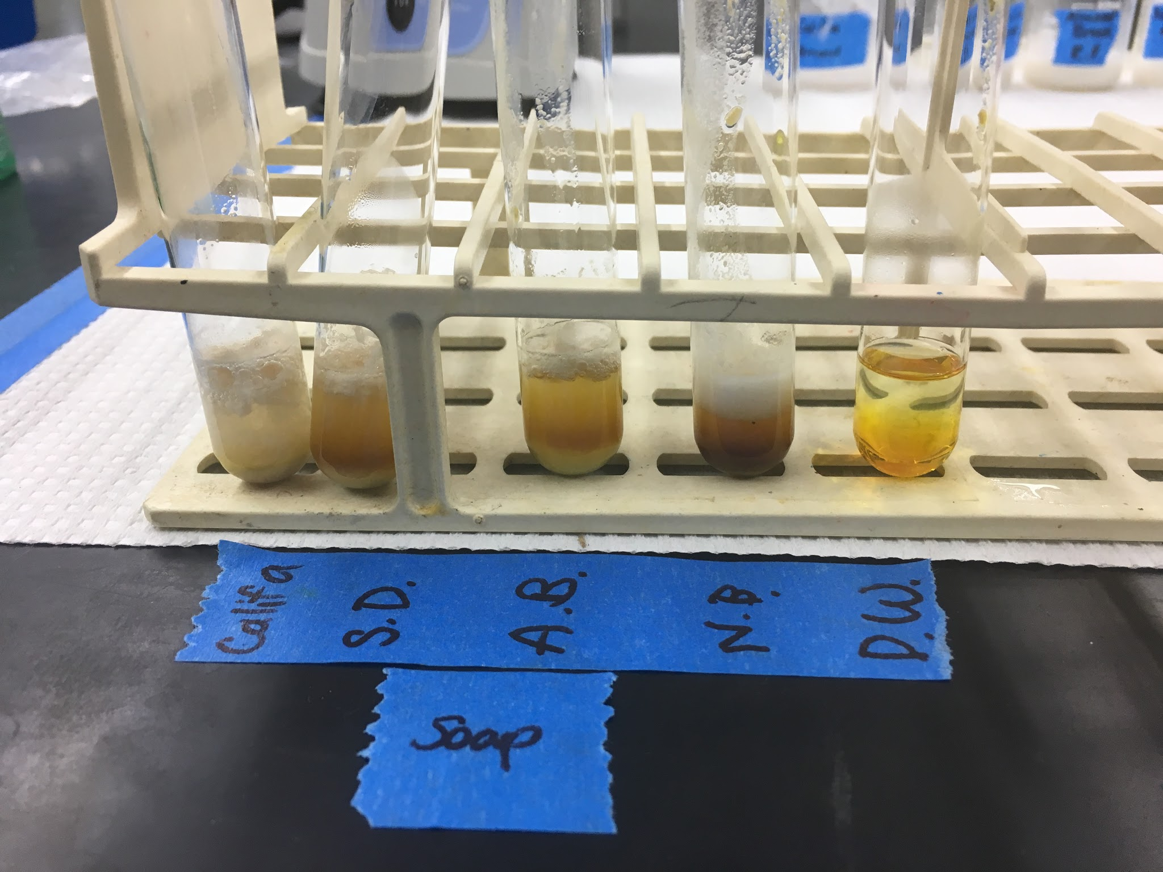
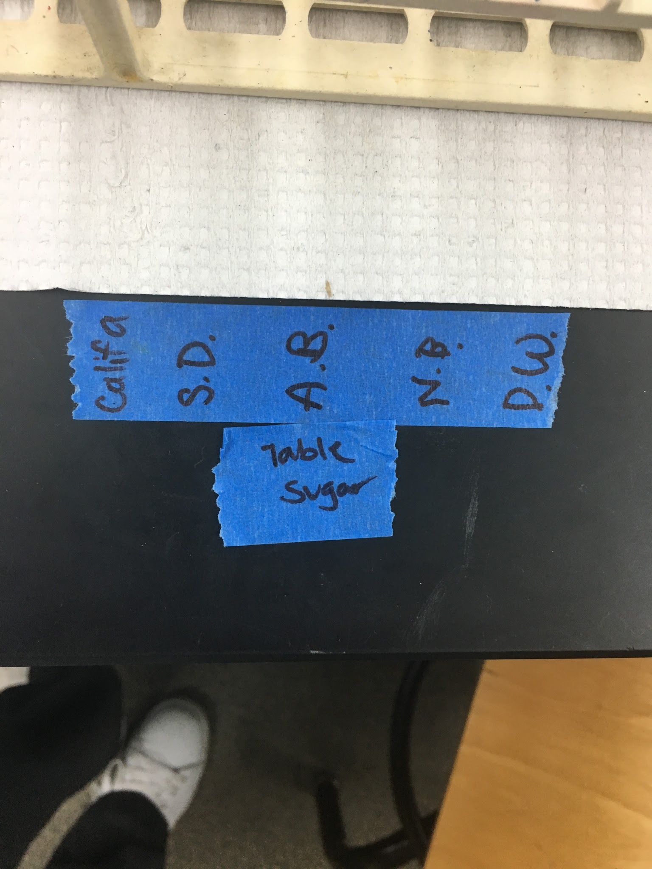
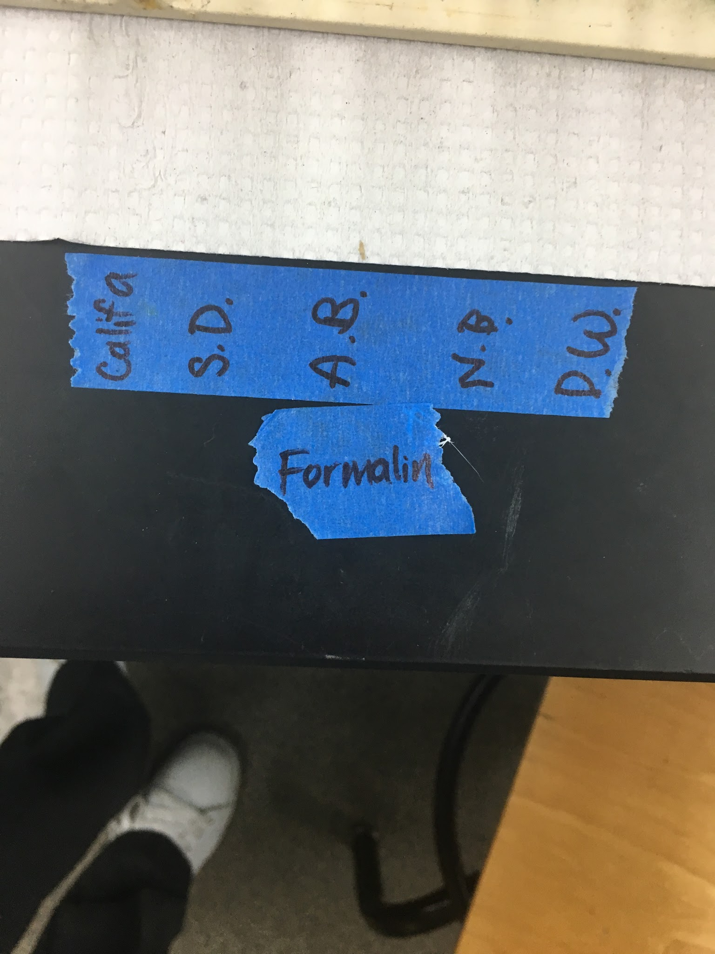
Adulteration of Milk: Almond Milk Brands Results
Results
Figure 12. Table Sugar Test Figure 13. Formalin Test

Slide 33
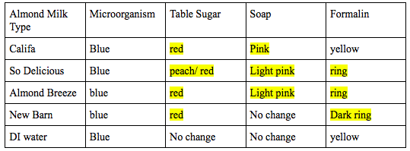
Adulteration of Milk: Almond Milk Brands Results
Results
___ = positive results

Slide 34

Difficulties
Did not have all the reagents
Making experiments for Amino Acid Lb viable without using fume hoods
Seaweed extract for testing

Slide 35
Improvements
Uniformity in lab experiments: Repeatability
Use of different solvents/dilutions
Prep time has improved significantly
Organization of results

Slide 36
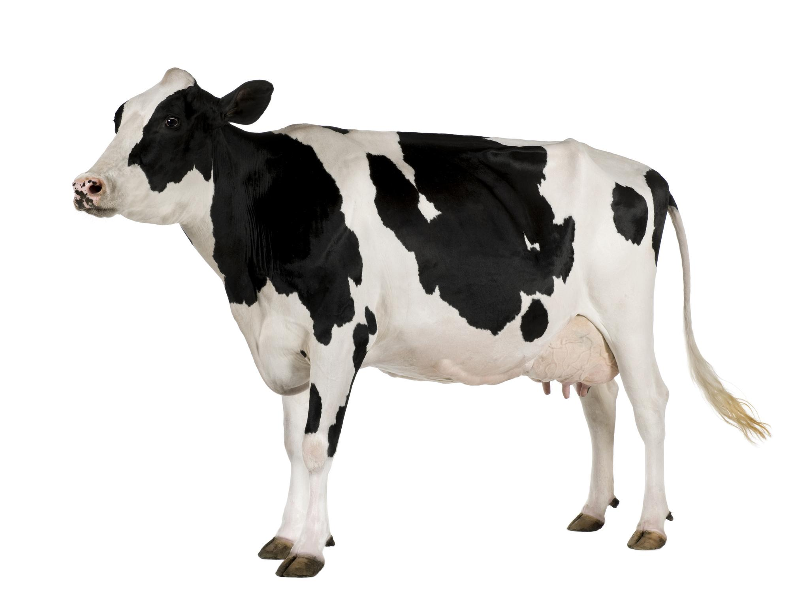
Upcoming Tasks
Rest of Qualitative Analysis of Amino Acids
Casein Extraction Milk Lab
Develop and implement Vitamin B lab
Develop and implement activated charcoal tests
Develop and implement chlorella tests

Slide 37
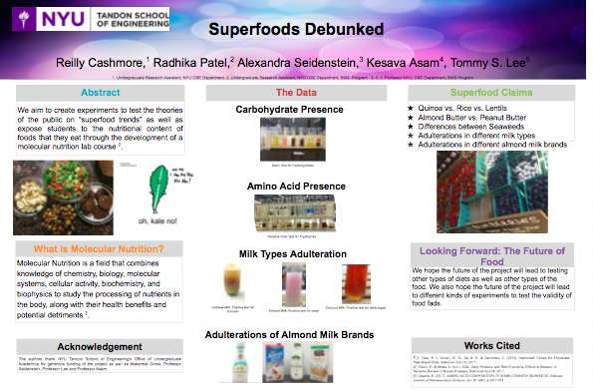
OUR POSTER

